Slide 1
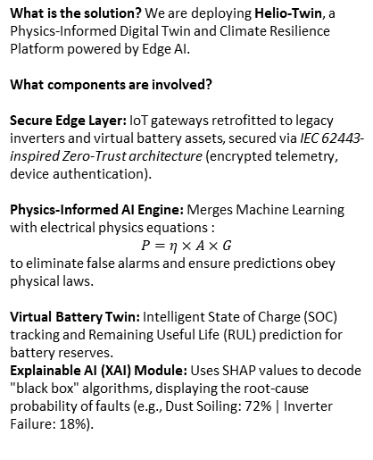
Project Name: Helio-Twin (Digital Twin & Edge-AI for Solar Resilience)
· Domain: Energy Systems By – Satvik Shrivastava Target SDGs: 7 (Clean Energy), 9 (Innovation), 13 (Climate Action)
01 / 04
01
PROBLEM
02
SYSTEM-GAPS
03
SOLUTION
DEFINING
NEED
MODEL
Define the problem clearly:
Identify system gaps
Design the solution
Library Printing Quad + Design Studio Plotters
Main Quadrangles + Decorative Botanical Gardens
Communal Restrooms, Student Residential Blocks
Summary:
Project Helio-Twin is an Edge-AI powered "Digital Twin" designed to rescue degraded rooftop solar infrastructure across academic campuses. By combining frugal IoT architecture with Physics-Informed Machine Learning, the system transitions solar maintenance from manual guesswork to prescriptive intelligence. Built specifically for the Global South, Helio-Twin slashes fault detection time from weeks to seconds, recovering up to 20% of lost renewable energy, automating ESG carbon accounting, and upskilling local electrical staff into "Green Digital Operators."
What is currently happening: O&M (Operations & Management) is entirely reactive and siloed. Systems trip without warning, and cleaning is based on arbitrary schedules rather than data.
Maintenance personnel reported that solar systems are typically inspected only once every few weeks due to manpower limitations.
Baseline Metrics Table: | Metric | Current Situation | Target with Helio-Twin | | Fault Detection Time :
| Weeks (Manual discovery) | < 5 Seconds (Automated) |
| Inspection Frequency:
| Once every 2–3 weeks | Continuous 24/7 Monitoring |
| Cleaning Schedule: | Reactive / Guesswork | Predictive (Data-driven) |
| Annual Energy Loss: | 15% to 20% | < 2% |
What is the solution? We are deploying Helio-Twin, a Physics-Informed Digital Twin and Climate Resilience Platform powered by Edge AI.
What components are involved?
Secure Edge Layer: IoT gateways retrofitted to legacy inverters and virtual battery assets, secured via IEC 62443-inspired Zero-Trust architecture (encrypted telemetry, device authentication).
Physics-Informed AI Engine: Merges Machine Learning with electrical physics equations :
$$P=η×A×G$$
to eliminate false alarms and ensure predictions obey physical laws.
Virtual Battery Twin: Intelligent State of Charge (SOC) tracking and Remaining Useful Life (RUL) prediction for battery reserves.
Explainable AI (XAI) Module: Uses SHAP values to decode "black box" algorithms, displaying the root-cause probability of faults (e.g., Dust Soiling: 72% | Inverter Failure: 18%).
Quantifying the Problem:
Undetected inverter failures can leave solar arrays offline for weeks, forcing the university to rely on grid electricity and undermining institutional climate commitments.
Our university operates approximately 150 kW of rooftop solar capacity. Due to severe dust accumulation and undetected grid-surge trips, we suffer a conservative 15% performance loss. This translates to nearly 32,000 kWh of lost clean electricity annually, costing the institution approximately ₹2.5 lakh in wasted utility bills and resulting in massive avoidable carbon emissions.
The university’s heavy investment in rooftop solar infrastructure is falling victim to "Ghost Generation." Severe dust/avian soiling and localized grid surges (common in regions like Jabalpur, Indore, Delhi-NCR, Lucknow, U.P. , M.P. , Bihar, Middle East and North Africa (MENA),

Slide 2
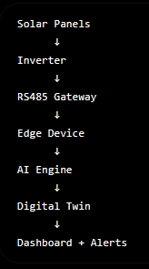
By - Satvik Shrivastava
02 / 04
Southwestern United States etc.) cause undetected inverter trips and heavy efficiency drops.
Inefficiency?
Missing?
REQUIREMENTS
COMPONENTS
Where it occurs:
This degradation is actively occurring across the New Academic Block and CSE/IT Department, Central Library, and the Ground Floor Sub-Station distributed rooftops, where extreme summer dust and heavy monsoon storms frequently compromise solar efficiency.
Why it’s important to solve?
Recent industry research shows that unmonitored solar systems lose 15% to 20% of their annual energy yield. Undetected inverter failures leave solar arrays offline for weeks. Expensive renewable hardware sits idle while the campus pulls baseline energy from the carbon-heavy municipal coal grid. This creates a massive financial deficit and turns institutional sustainability into accidental greenwashing.
Baseline Metrics Table: | Metric | Current Situation | Target with Helio-Twin | | Fault Detection Time :
| Weeks (Manual discovery) | < 5 Seconds (Automated) |
| Inspection Frequency:
| Once every 2–3 weeks | Continuous 24/7 Monitoring |
| Cleaning Schedule: | Reactive / Guesswork | Predictive (Data-driven) |
| Annual Energy Loss: | 15% to 20% | < 2% |
What is inefficient or missing?
Blind Operations: Legacy inverters lack a Digital Public Infrastructure (DPI) telemetry layer.
No Predictive Resilience: The system cannot anticipate weather risks (incoming dust storms/monsoons) to alter operations.
No Decision Support: Maintenance relies entirely on overburdened human memory and physical walks, creating a single point of failure in operations.
Black-Box Vulnerability: Current systems lack Explainable AI (XAI) and Zero-Trust Cybersecurity, making the grid vulnerable and untrustworthy.
The campus lacks a Digital Public Infrastructure (DPI) layer for its environmental data. Without telemetry, a grid surge caused by a monsoon storm will trip an inverter, leaving the campus running on fossil fuels for weeks before human staff even realizes the system is offline. Furthermore, panel cleaning schedules are based
on guesswork, not real-time soiling data.
What components are involved?
By leveraging low-cost edge-computing microcontrollers (ESP32 or Raspberry Pi) and open-source ML models, we achieve enterprise-grade Digital Twin capabilities at a fraction of the cost, making it highly accessible for educational institutions in the Global South.
Hardware: Low-cost IoT gateways connected to existing inverters.
AI/ML Engine: An Isolation Forest algorithm for millisecond anomaly detection (inverter trips) and a Predictive Regression model for Soiling Index calculations.
UI/UX: A centralized Digital Twin Dashboard for the Facility Management Office, featuring automated WhatsApp/SMS alerts for ground staff.

Slide 3
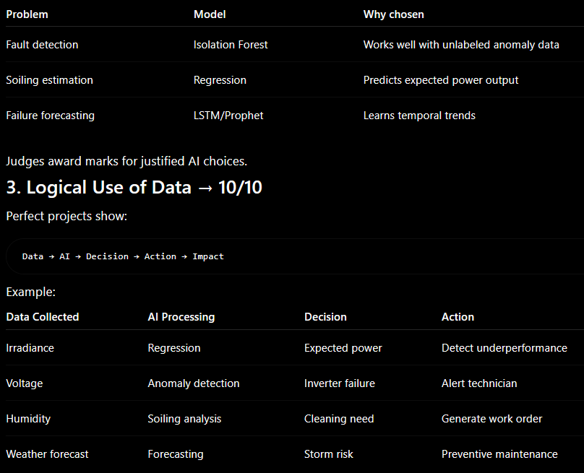
By – Satvik Shrivastava
03 / 04
03
WORKFLOW
WHY
04
INFO
HOW
Design the solution
Define the data flow
Physical Layer:
Solar panels
Inverters
Sensors
Edge Layer:
ESP32/Raspberry Pi
AI Layer:
Isolation Forest
Regression
Forecasting
Application Layer:
Dashboard
WhatsApp alerts
Decision Layer:
Maintenance recommendations
What data will be collected?
System Data: High-frequency Kilowatt-hours (kWh), string voltage, and current (via Inverter APIs).
Geospatial Data: Real-time solar irradiance (W/m²) and humidity via open-source satellite APIs (e.g., NASA POWER or local weather stations).
How will it be used?
The Digital Twin runs continuous simulations. If it is a bright, sunny day (high irradiance) but the AI detects a 0 kWh output, it instantly knows the inverter has tripped. If output slowly degrades by 18% over a month despite clear skies, the AI identifies dust accumulation.
What decisions will it enable?
Micro-Decision (Fault Alert): Slashes the Mean Time To Detect (MTTD) from "weeks" to "seconds," instantly notifying staff: "Inverter #2 Tripped. Reset required.“
Macro-Decision (Predictive Maintenance): The AI dynamically calculates the cost of lost energy versus the cost of cleaning labor. It triggers a cleaning ticket only when the energy loss is more expensive than hiring the cleaning staff.
Incoming telemetry is validated, cleaned, and time-synchronized before AI processing to ensure reliable predictions.

Slide 4
By – Satvik Shrivastava
03 / 04
04
COST?
04
Define the Data-flow and Decision Intelligence
Define the Data flow and Decision Intelligence
Live inverter telemetry, battery health metrics, and forecasted meteorological data (irradiance, heatwaves, cloud cover).
The data feeds a highly advanced simulation and decision-support matrix.
What decisions will it enable?
Prescriptive AI (Maintenance): Instead of "Alert: Dirty Panel," the AI calculates: "Action: Clean Array B. Cost: ₹500. Expected Savings: ₹2,700. ROI Positive.“
Extreme Weather Risk Forecasting: Anticipates a 60% irradiance drop from a monsoon or grid instability from a heatwave, automatically recommending battery reserve charging.
Scenario Simulation ("What-If" Engine): Allows facility managers to simulate stress tests: "What if campus demand rises 25% while Inverter #2 fails?“
Macro-Decision (Automated Carbon Accounting): The Digital Twin converts recovered kWh directly into 'Kilograms of CO2 Avoided' based on the local grid's carbon intensity. This provides transparent, audit-ready data for the university’s annual ESG reports and Scope 2 emission reductions
Divided implementation into phases.
Phase 1: Prototype (0-2 months)
Simulated inverter dataset
NASA POWER API
Streamlit dashboard
AI models
Cost: ₹0–₹1000
Phase 2: Pilot Deployment (3-6 months)
One building
One inverter
One gateway
Cost: ₹3000–₹5000
Phase 3: Campus Scale
Multiple buildings
Central monitoring
Include a cost table
Total:
Approximately ₹800-₹1000 for proof-of-concept.
If live inverter telemetry is unavailable during the prototype stage, historical and simulated datasets will be used.
Component | Prototype Cost
NASA API | ₹0
Python libraries | ₹0
Streamlit | ₹0
Firebase | ₹0
ESP32 | ₹500
RS485 converter | ₹300
Does not necessarily represent the actual prototype

Slide 5
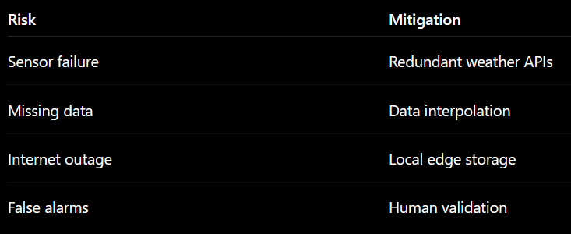
By – Satvik Shrivastava
03 / 04
05
Impact
05
Expected Impact
Expected Impact
What improvement will it bring?
It mathematically eliminates "Ghost Generation," recovering up to 20% of lost clean energy capacity. It also aligns with India's MNRE (Ministry of New and Renewable Energy) push for mandatory Remote Monitoring Systems (RMS) in smart grids.
Who will benefit?
Environmental (Planet): Maximizes the university's green energy offset, explicitly advancing SDG 13.
Economic (Profit): Delivers a provable, rapid ROI by eliminating unnecessary utility grid purchases and optimizing cleaning budgets.
Social (People - The "Green Skills" Factor): This is the ultimate Just Transition. We upskill maintenance staff (like Vijay) from reactive physical laborers to proactive "Digital Twin Operators." Furthermore, the dashboard acts as a "Living Lab" for CS students to study Applied AI on their own campus.
The Global Education Sector: Once validated on our campus, the 'Helio-Twin' ML algorithms and dashboard blueprints will be packaged as an Open-Source Digital Public Good (DPG) on GitHub. Any under-resourced university globally can download and deploy the system, scaling our local solution into a global green-skills standard.
Shifts the campus from reactive maintenance to Prescriptive Decision Intelligence. By extending the Remaining Useful Life (RUL) of components and preventing downtime, it maximizes the institution's financial and ecological investments.
Global ESG Reporting: The built-in Automated Carbon MRV Engine (Monitoring, Reporting, Verification) automatically translates recovered kWh into auditable metrics (e.g., "697 kg CO₂ Avoided, 31 Trees Equivalent"), ready for institutional ESG reports.
The Wider Digital Ecosystem (DPI): The platform features a Green DPI API (Open Environmental Data Exchange). By exposing endpoints like GET /solar_forecast and GET /carbon, other local municipalities, researchers, or grid operators can interoperate with our data, fully aligning with UNEP's vision for open environmental digital goods.
The Local Workforce: Upskills campus electricians to interact with trustworthy, explainable AI, establishing a scalable blueprint for the "Green Jobs for Youth" transition.

